Slide 1
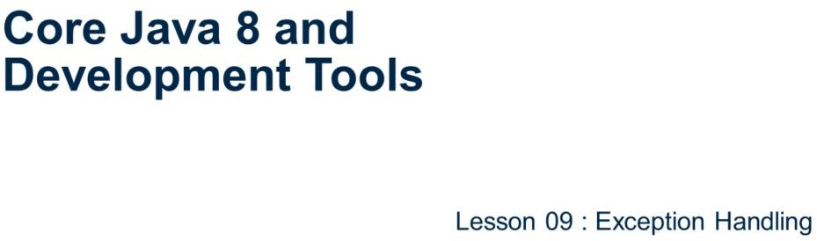
Core Java 8 and Development Tools
Exception Handling
Page 09-1

Slide 2
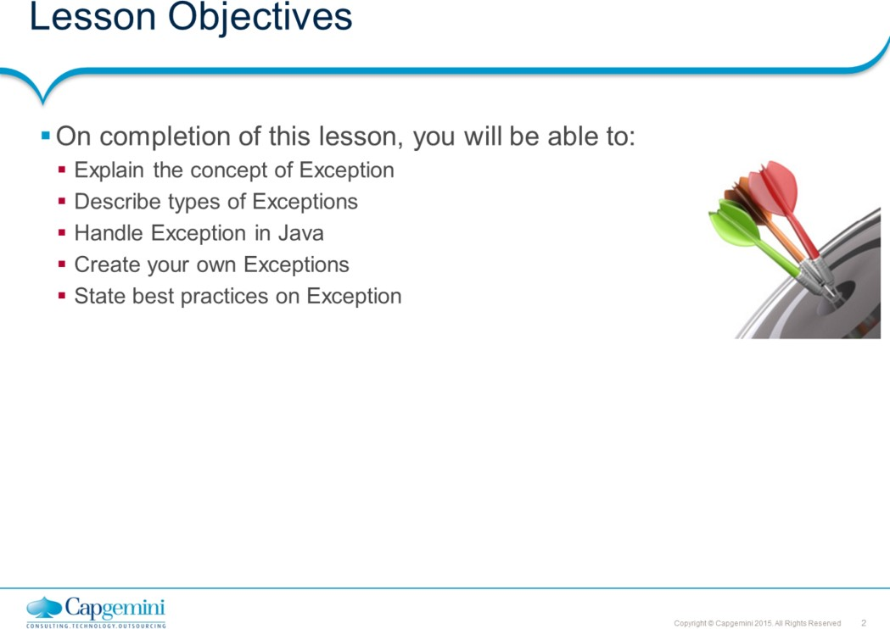
Core Java 8 and Development Tools
Exception Handling
This lesson deals with Java’s exception-handling mechanism. An exception is an abnormal condition that arises in a code sequence at run time. In other words, an exception is a run-time error.
Lesson Outline:
: Introduction
: Exception Types
: Exception Hierarchy
: Try-catch-finally
: Try-with-resources 9.6: Multi catch blocks
9.7: Throwing exceptions using throw 9.8: Declaring exceptions using throws 9.9: User defined Exceptions
9.10: Best Practices
Page 09-2

Slide 3
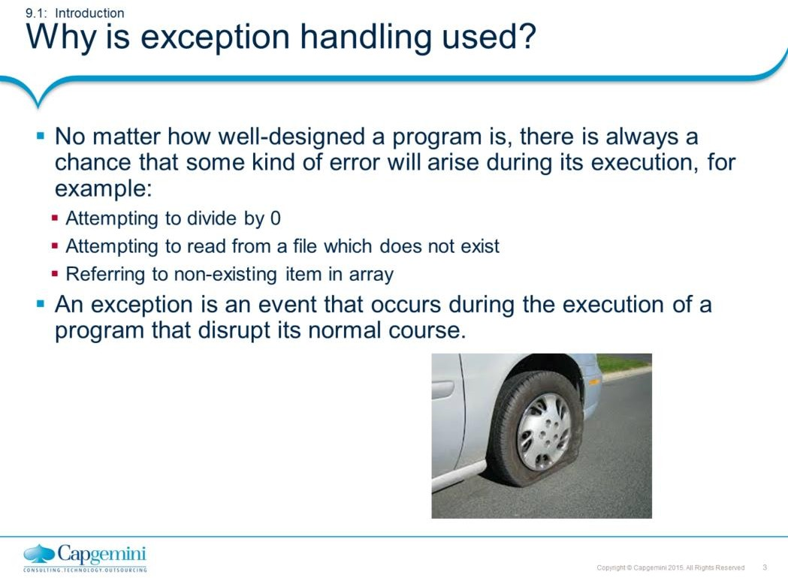
Core Java 8 and Development Tools
Exception Handling
Why Exception Handling?
Java was designed with the understanding that errors occur, that unexpected events happened and the programmer should always be prepared
for the worst. The preferred way of handling such conditions is to use exception handling, an approach that separates a program’s normal code from its error- handling code.
Page 09-3

Slide 4
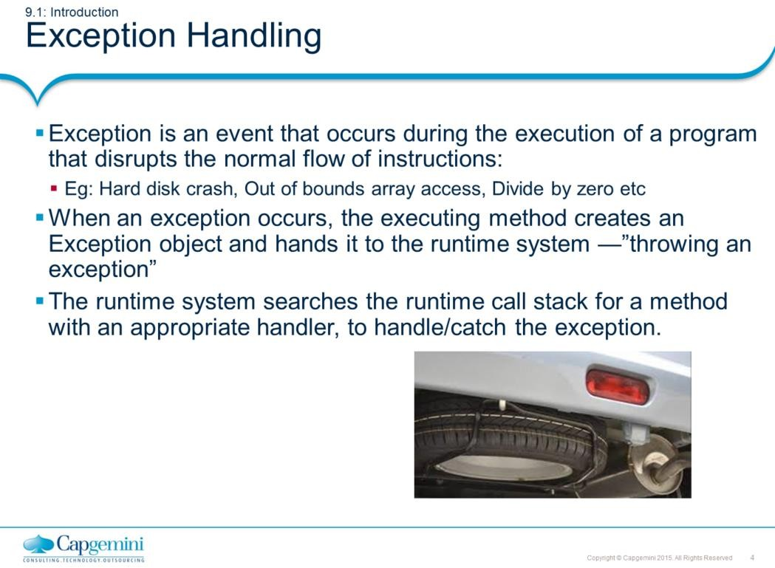
Core Java 8 and Development Tools
Exception Handling
Exception Handling:
An exception is an event that occurs during the execution of a program that disrupts the normal flow of instructions. Exceptions are used as a way to report occurrence of some exceptional condition. Exception provides a means of communicating information about errors up through a chain of methods until one of them handles it.
Note: Java exception handling is similar to the one used in C++.
The exception mechanism is built around the throw-and-catch paradigm. When an error occurs within a Java method, the method creates an exception object and hands it off to the runtime system. This process is known as throwing an exception. The exception object contains information about the exception, including its type and the state of the program when the error occurred. To catch an exception is to take appropriate action to deal with the exception.
Java’s Exception handling mechanism is managed by five keywords: try, catch, throw, throws and finally.
Page 09-4

Slide 5
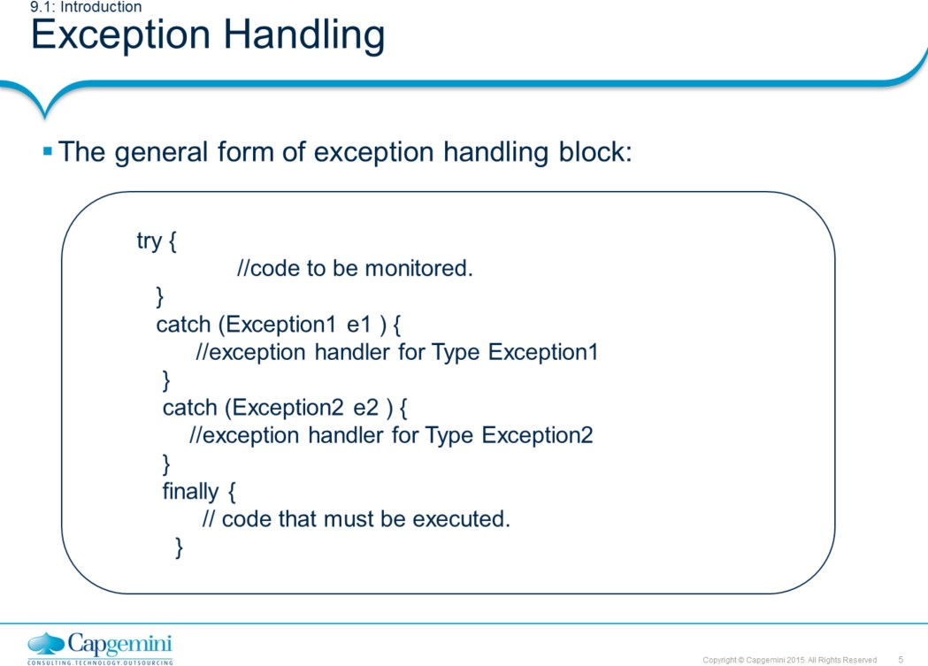
Core Java 8 and Development Tools
Exception Handling
Exception Handling (Contd.):
Normally, the program code that you want to observe for exceptions is written in the try block. If an exception occurs within a try block, it is thrown. Your code can catch this exception (using the catch block), handle the situation gracefully and continue to be in a program. Any code, that absolutely must be executed, regardless of whether exception has occurred or not, can be put into finally block.
In the above code fragment, Exception1 and Exception2 are being caught. The default handler ultimately processes an exception that is not caught by your program. The default handler displays a string describing the exception, and prints a stack trace from the point at which the exception occurred.
.
Page 09-5

Slide 6
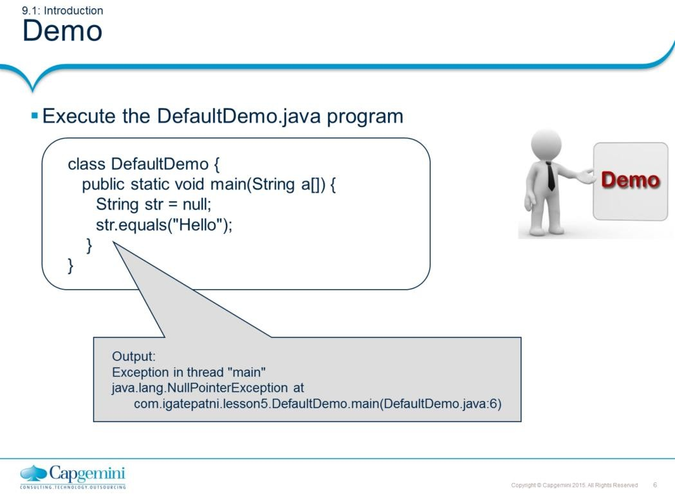
Core Java 8 and Development Tools
Exception Handling
The code throws a Exception:
Exception in thread "main" java.lang.NullPointerException at DefaultDemo.main(DefaultDemo.java:5)
This is because the String Object is not created and is therefore Null. When methods are invoked on such referenced objects, a NullPointerException is thrown!
Page 09-6

Slide 7
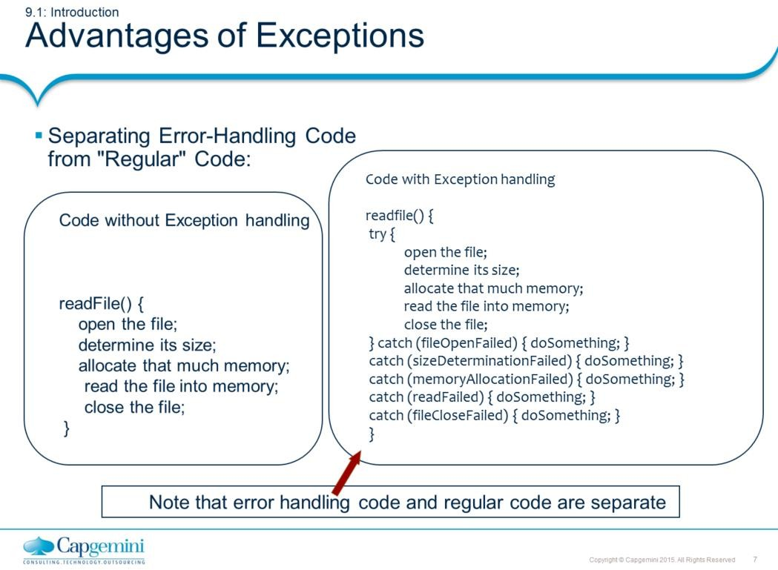
Core Java 8 and Development Tools
Exception Handling
Advantages of Exceptions:
Exceptions provide the means to separate the details of what to do when something exceptional happens, which differs from the main logic of a program. Refer to the code snippet without Exception handling. At first glance, this function seems simple enough, but it ignores all the following potential errors.
What happens if the file can't be opened?
What happens if the length of the file can't be determined? What happens if enough memory can't be allocated?
What happens if the read fails?
What happens if the file can't be closed?
Page 09-7

Slide 8
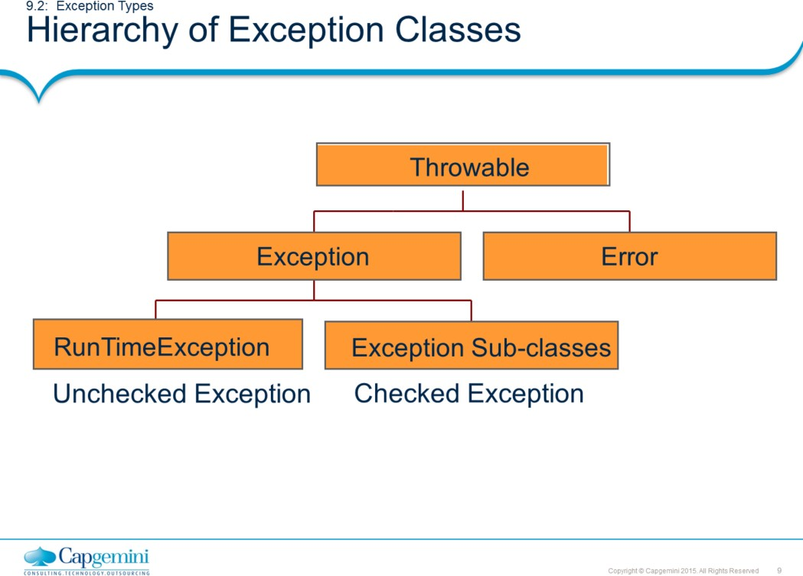
Core Java 8 and Development Tools
Exception Handling
Hierarchy of Exception Classes:
All exceptions are derived from the java.lang.Throwable class. Throwable is at top of the execution class hierarchy. Immediately below Throwable are two subclasses, Error and Exception, which categorize exceptions into two distinct branches.
Exception class: This class is used for exceptional conditions that user programs should catch. This is also the class that you use as a subclass to create your own custom exception types. There is an important subclass of Exception, called RuntimeException.
Error class: This class defines exceptions that are not expected to be caught under normal circumstances by your program. Exceptions of type Error are used by the Java run-time system to indicate errors having to do with the run-time environment, itself. Stack overflow is an example of such an error.

Slide 9
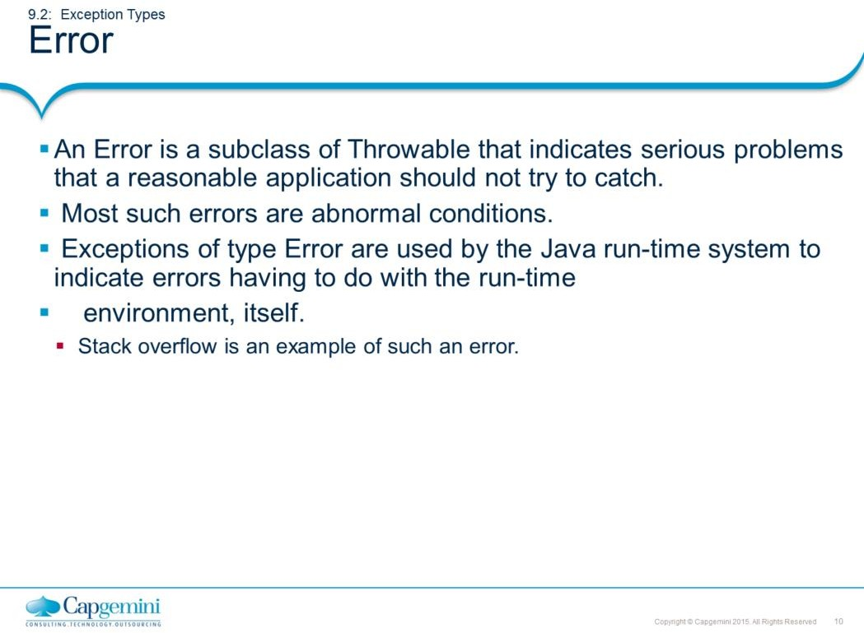
Core Java 8 and Development Tools
Exception Handling
Error:
Instances of Error are internal errors in Java runtime environment. These are rare and usually fatal and therefore not supposed to be handled by the program.
Instances of error are thrown, when the Java Virtual Machine faces some memory leakage problem, insufficient memory problem, dynamic linking failure or when some other "hard" failure in the virtual machine occurs. Obviously, in case of an error, the program stops executing.

Slide 10
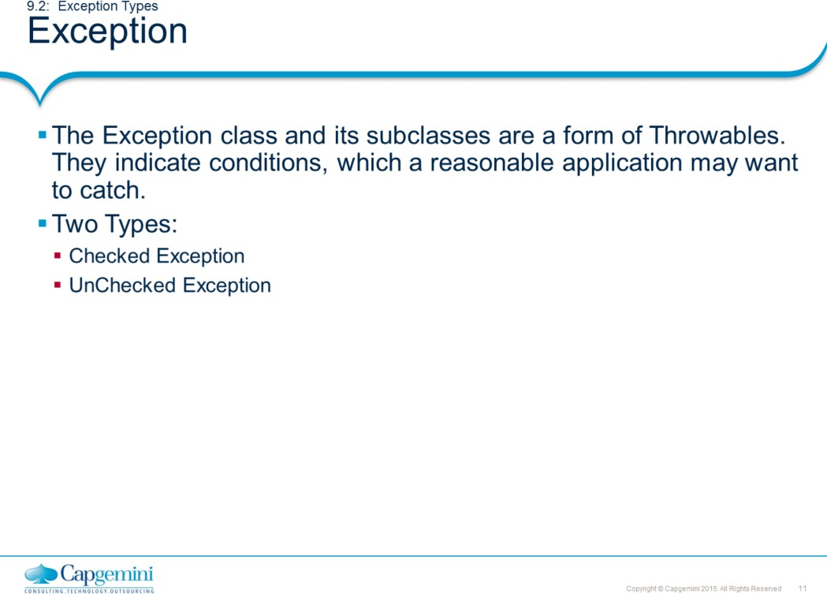
Core Java 8 and Development Tools
Exception Handling
Java distinguishes between two categories of exceptions:
Checked exceptions Unchecked exceptions
This distinction is important, because the Java compiler enforces a catch-or- declare requirement for checked exceptions. An exception's type determines whether the exception is checked or unchecked. All classes that inherit from the Exception class but not the RuntimeException class are considered to be checked exceptions. The compiler checks each method call and method declaration to determine whether the method throws checked exceptions. If so, the compiler ensures that the checked exception is caught or is declared in a throws clause.

Slide 11
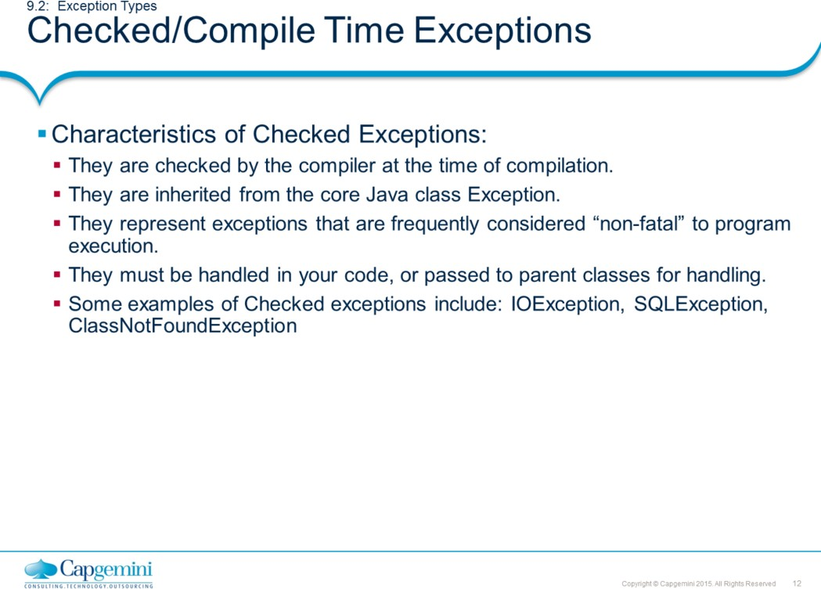
Core Java 8 and Development Tools
Exception Handling
Example:
try {
DriverManager.registerDriver (new oracle.jdbc.driver.OracleDriver());
Connection conn = DriverManager.getConnection (
"jdbc:oracle:thin:@DbServer:trgdb", “scott", “tiger");
……
} catch (SQLException e) {
System.out.println(e.getMessage());
}
An SQLException can be thrown while attempting to connect to database. Hence must be caught.

Slide 12
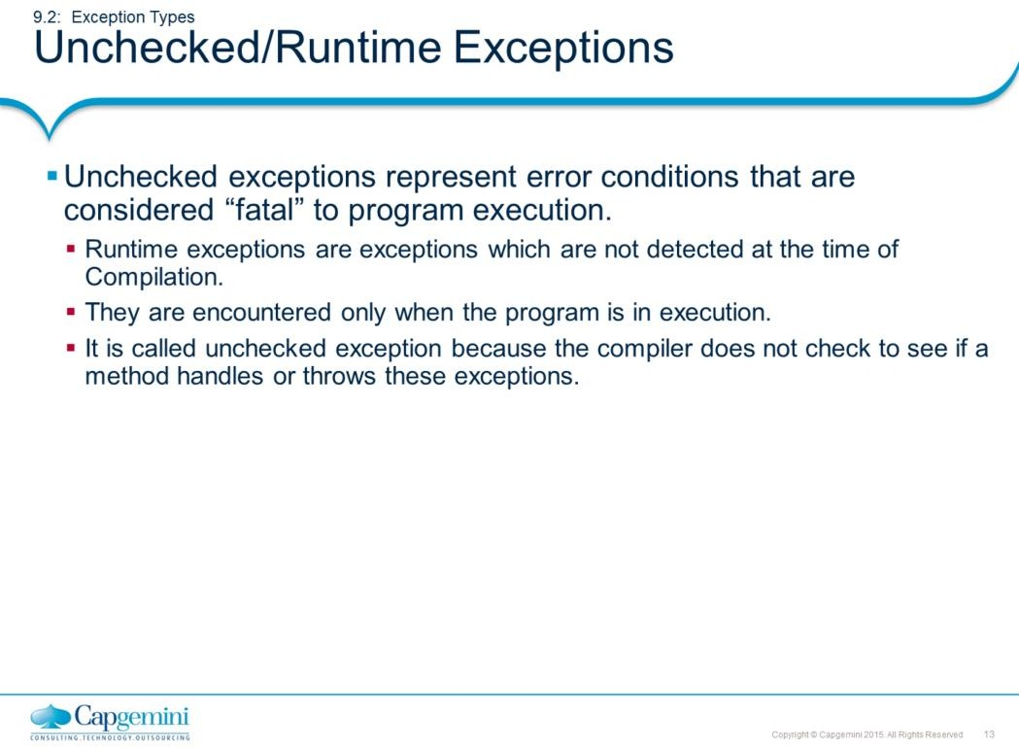
Core Java 8 and Development Tools
Exception Handling
Unchecked/Runtime Exceptions:
These kind of exceptions are encountered only while the program is in execution. Program may take actions to handle them explicitly or are propagated till java run- time handles them. In the latter case, program is terminated abruptly.
Before you learn to handle exceptions in a program, it is useful to understand what happens when they are not handled. This program includes a code that causes NullPointerException because an object of the String class is not created.
class DefaultDemo {
public static void main(String a[]) {
String str = null; str.equals(“Hello”);
}
}
This program will compile properly. When java run-time system detects the attempt to call equals() method on null object, it constructs a new exception object and throws this exception. This halts the execution of program, because once an exception has been thrown, it must be caught by an exception handler and dealt with immediately. As there is no explicit exception handler defined, it is handled by the default handler. The default handler displays a string describing the exception; prints stack trace and terminates the program.

Slide 13
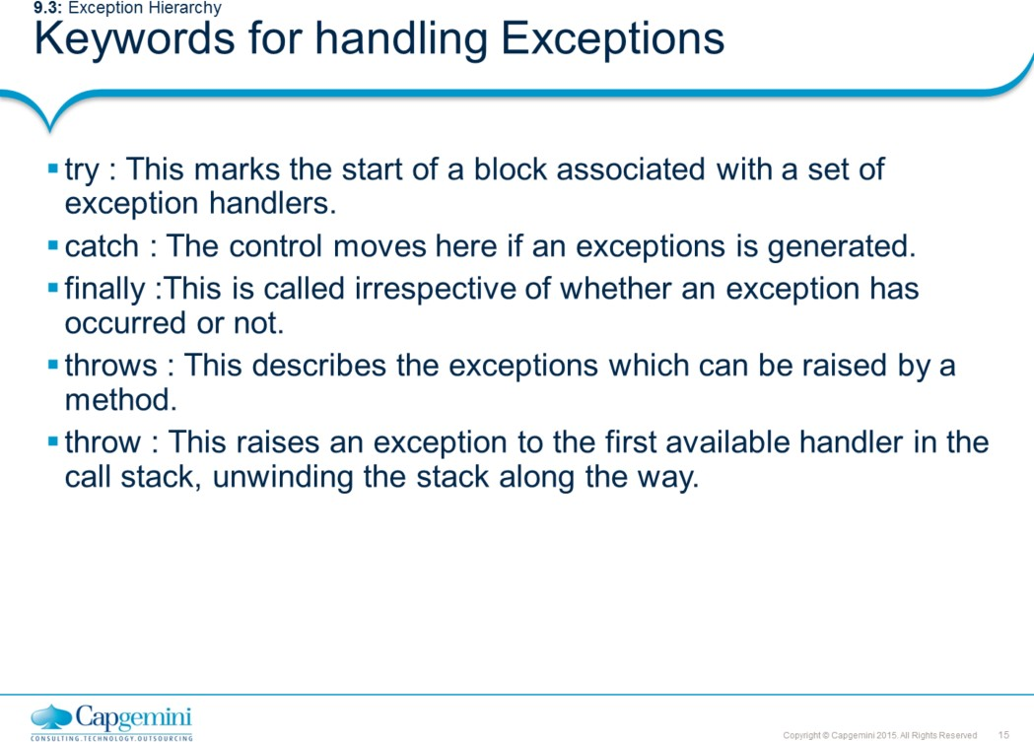
Core Java 8 and Development Tools
Exception Handling
Mnemonic Hint: Throw two and try to catch finally.

Slide 14
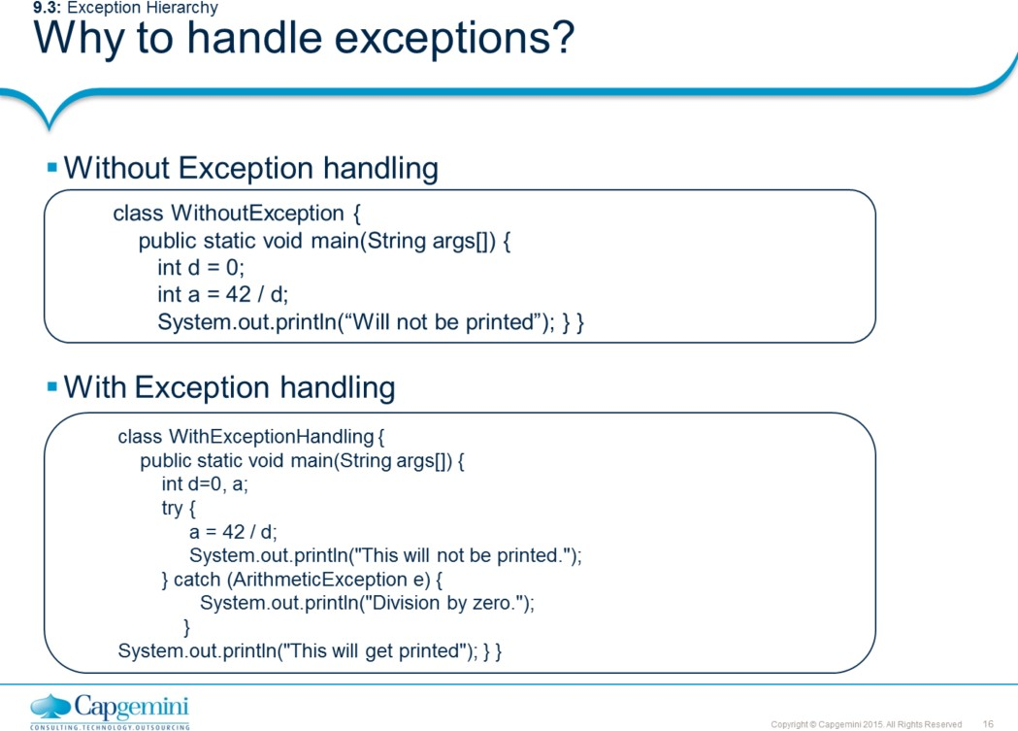
Core Java 8 and Development Tools
Exception Handling
Why to handle exceptions?
The code in box #1includes an expression that intentionally causes a divide-by- zero error.
When the Java run-time system detects the attempt to divide by zero, it constructs a new exception object and then throws this exception. This causes the execution of WithoutException to stop, because once an exception has been thrown, it must be caught by an exception handler and dealt with immediately.
In this example, exception handlers haven’t been supplied, so the exception is caught by the default handler provided by the Java run-time system. Any exception that is not caught by this program is ultimately processed by the default handler.
The default handler displays a string describing the exception, prints a stack trace from the point at which the exception occurred, and terminates the program. Here is the output generated when this example is executed.
java.lang.ArithmeticException: / by zero at WithoutException.main(Exc0.java:4)
Handling an Exception yourself provides two benefits. First, it allows you to fix the error. Second, it prevents the program from automatically terminating. The user of your application would be confused if your program stopped running and printed a stack trace whenever an error occurred.

Slide 15
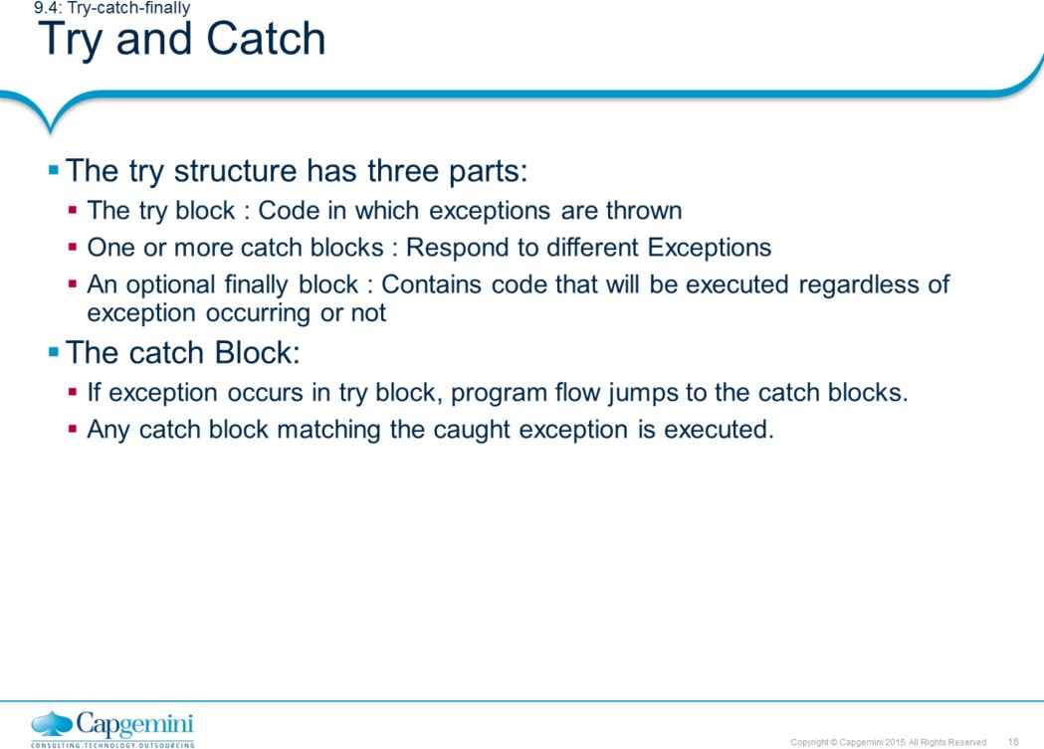
Core Java 8 and Development Tools
Exception Handling
Syntax for the try and catch block is shown on page 5-05.
The default exception handler provided by java run-time system is useful for debugging. However, it’s a good programming practice for the user to handle the exceptions.
The same example with exception handling is shown below. Observe the difference in the output. A try statement must be accompanied by at least one catch block and if required, one finally block.
class TryCatchDemo {
public static void main(String a[]) { String str = null;
try {
str.equals("Hello");
} catch(NullPointerException ne) {
str = new String("Hello"); System.out.println(str.equals("Hello"));
}
System.out.println("Continuing in the program");
}
}
The output is:
True
Continuing in the program…

Slide 16
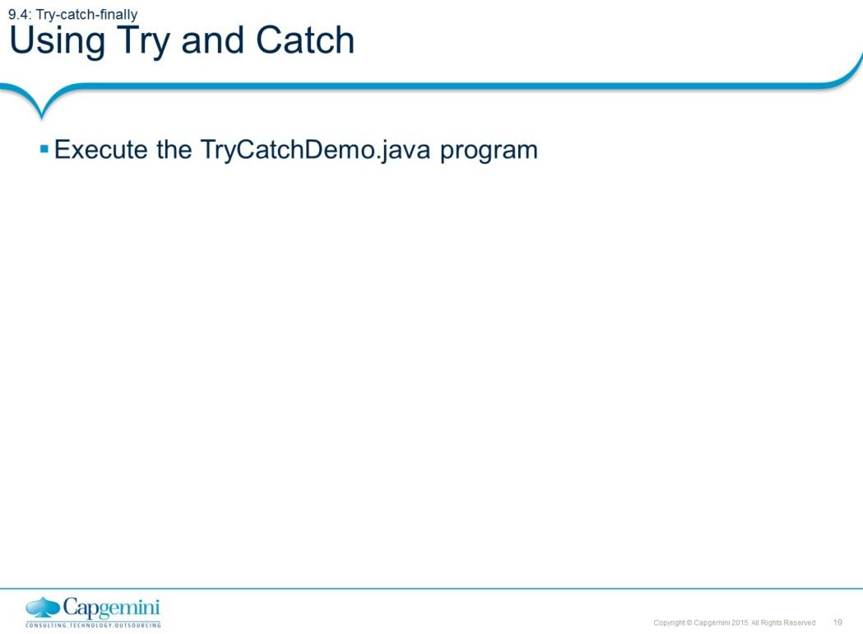
Core Java 8 and Development Tools
Exception Handling
The code is shown in the previous page.

Slide 17
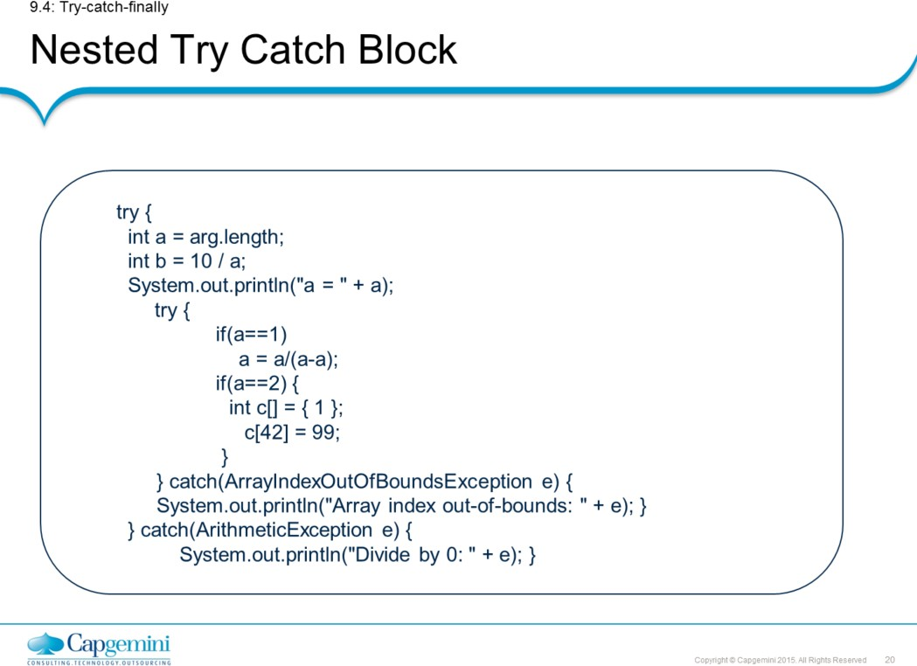
Core Java 8 and Development Tools
Exception Handling
Nested Try Catch Block:
The try statement can be nested. If an inner try statement does not have a catch handler for a particular exception, the stack is unwound and the next try statement’s catch handlers are inspected for a match. This continues until one of the catch statements succeeds, or until all of the nested try statements are exhausted. If no catch statement matches, then the Java run-time system handles the exception.
class Nesteddemo {
public static void main(String arg[]) { try {
int a = arg.length; int b = 10 / a;
System.out.println("a = " + a);
try {
if(a==1)
a = a/(a-a);
if(a==2) {
int c[] = { 1 }; c[42] = 99;
}
} catch(ArrayIndexOutOfBoundsException e){ System.out.println("Array index out-of-bounds:"+ e); }
} catch(ArithmeticException e) {
System.out.println("Divide by 0: " + e); } } }

Slide 18
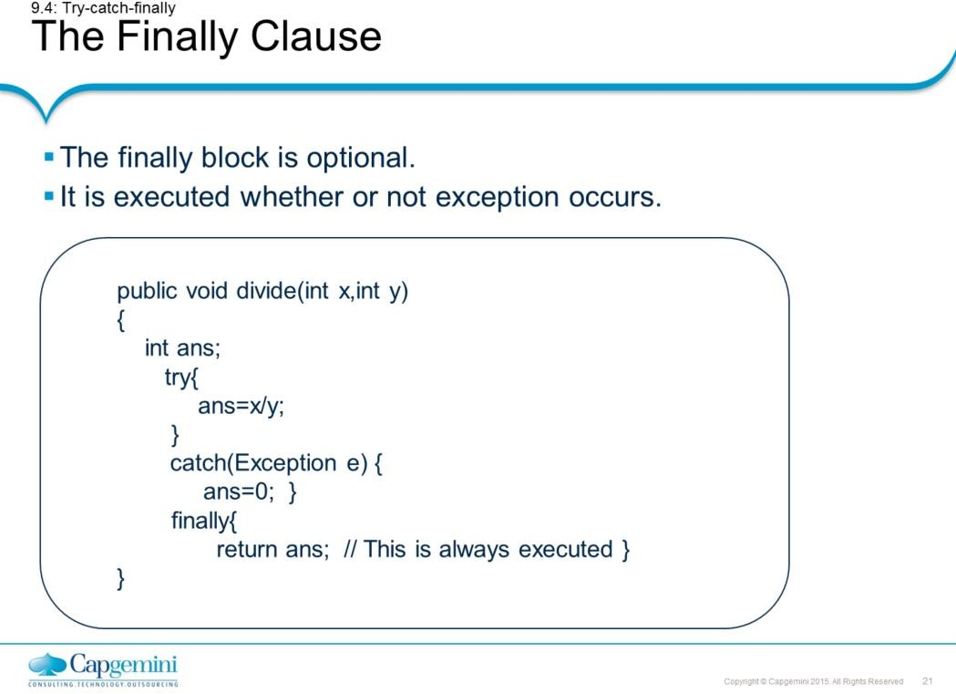
Core Java 8 and Development Tools
Exception Handling
The Finally Clause:
When exceptions are thrown, execution in a method takes a rather abrupt, nonlinear path that alters the normal flow through the method. Depending upon how the method is coded, the method may return prematurely. For example, if a method opens a database connection on entry and closes it upon exit, then you will not want the code that closes the file to be bypassed by the exception-handling mechanism. The finally keyword is designed to address this contingency.
Finally creates a block of code that is executed after try/catch block has completed and before the code following the try/catch block. The finally block executes whether or not an exception is thrown.
If an exception is thrown, the finally block executes even if no catch statements matches the exception. Finally is guaranteed to execute, even if no exceptions are thrown. The Finally block is an ideal position for closing the resources such as file handle or a database connection, and so on.
A finally block typically contains code to release resources acquired in its corresponding try block; this is an effective way to eliminate resource leaks. For example, the finally block should close any files opened in the try block.

Slide 19
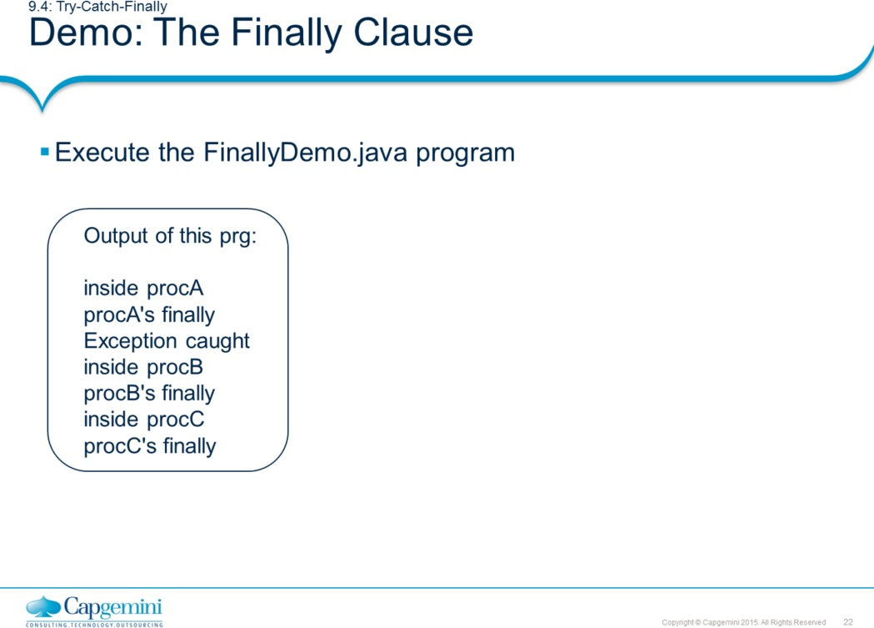
Core Java 8 and Development Tools
Exception Handling
class FinallyDemo { static void procA() {
try {
System.out.println("inside procA"); throw new RuntimeException("demo");
} finally { System.out.println("procA's finally"); }
}
static void procB() { // Return from within a try block. try {
System.out.println("inside procB"); return;
} finally { System.out.println("procB's finally"); }
}
static void procC() { // Execute a try block normally. try {
System.out.println("inside procC");
} finally { System.out.println("procC's finally"); }
}
public static void main(String args[]) { try {
procA();
} catch (Exception e) { System.out.println("Exception caught"); } procB(); procC();
} }

Slide 20
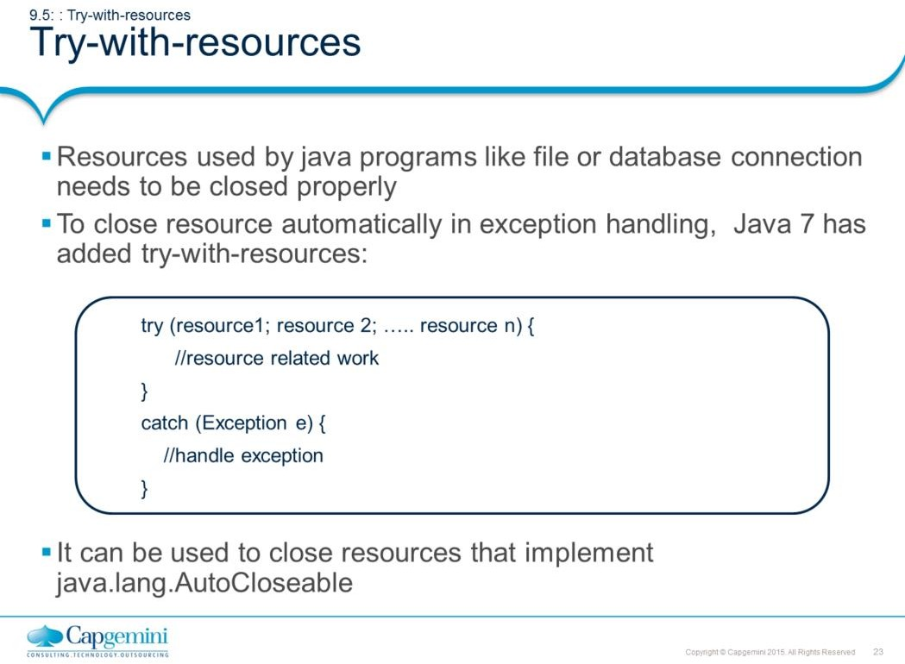
Core Java 8 and Development Tools
Exception Handling
Many times Java programs need to work with resources like file, database connection or network socket etc. After work, such resources must be closed gracefully to avoid loss of data. There are two places in exception handling where resource can be closed.
Finally Block (will be discussed later) try-with-resources
A try-with-resources is a new feature added in java 7, where resources are closed automatically. Any block after try (either catch or finally block) will be executed only after the resource is closed.

Slide 21
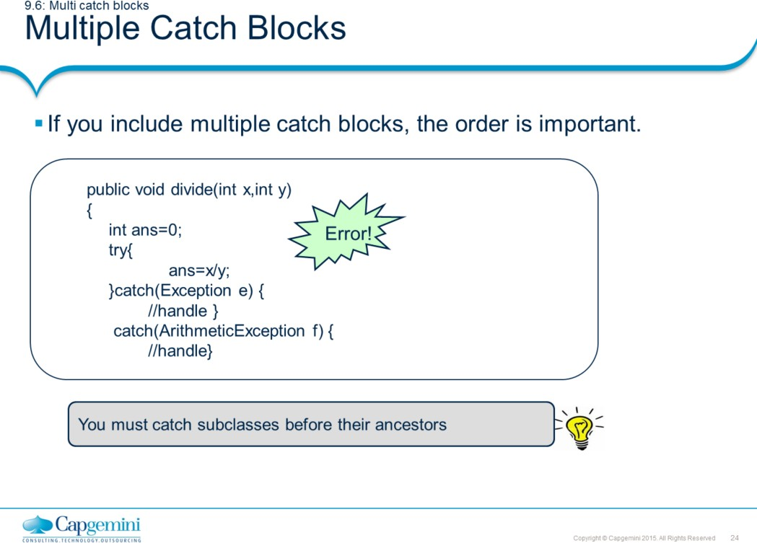
Core Java 8 and Development Tools
Exception Handling
Multiple Catch Blocks:
The following example shows the uses of multiple catch clauses.
class MultiCatch {
public static void main(String args[]) { try {
int a = args.length; System.out.println("a = " + a); int b = 42 / a;
int c[] = { 1 }; c[42] = 99;
} catch(ArithmeticException e) { System.out.println("Divide by 0: " + e); }
catch(ArrayIndexOutOfBoundsException e) { System.out.println("Array index oob: " + e); }
catch(Exception e) {
System.out.println("Generic Exception: " + e); } System.out.println("After try/catch blocks.");
}
Output:
a = 0
Divide by 0: java.lang.ArithmeticException: / by zero After try/catch blocks.

Slide 22
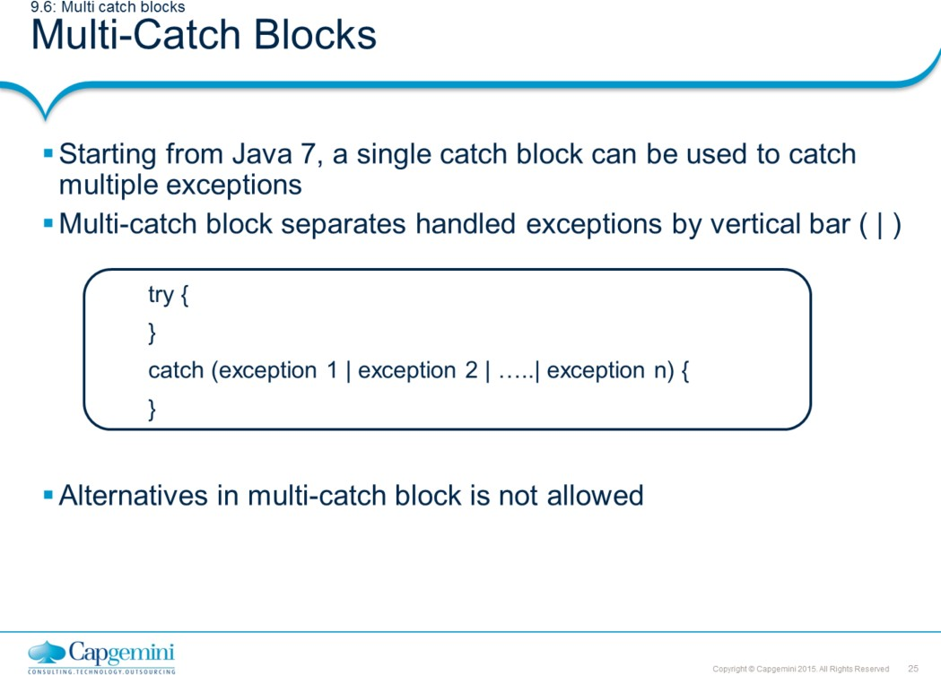
Core Java 8 and Development Tools
Exception Handling
Multiple-catch blocks:
Java 7 allows a single catch block to catch multiple exceptions. The only precaution required is not to list multiple exceptions which are related by sub classing. It means you cannot catch child and parent exception in multi-catch block. The following example throws an error as ArithmeticException is subclass of Throwable and hence cannot be combined in multi-catch block.
class MultiCatch {
public static void main(String args[]) { try {
int a = args.length; System.out.println("a = " + a); int b = 42 / a;
int c[] = { 1 }; c[42] = 99;
} catch(ArithmeticException | Throwable e) {
System.out.println(“Exception: " + e);
}
System.out.println("After try/catch blocks.");
}
Error!

Slide 23
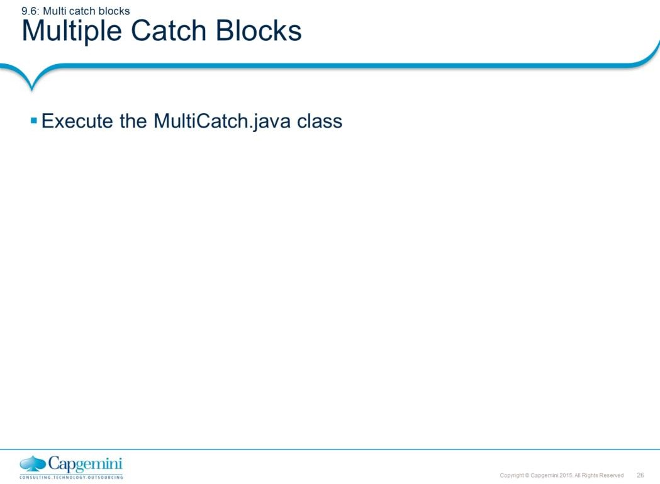
Core Java 8 and Development Tools
Exception Handling
The code for this example is shown in the previous page.
The last catch block is a generic catch block, which can catch all kinds of exceptions. This is a generalized catch block and should always appear as a last block in the list of catch blocks. If first two blocks cannot handle the exception thrown, it will be definitely handled by a generic block.
Try and catch blocks can be nested and if inner catch blocks are unable to handle an exception, it’s escalated to the outer catch blocks. This continues until either one of the catch blocks handles the exception or all the try statements are exhausted.

Slide 24
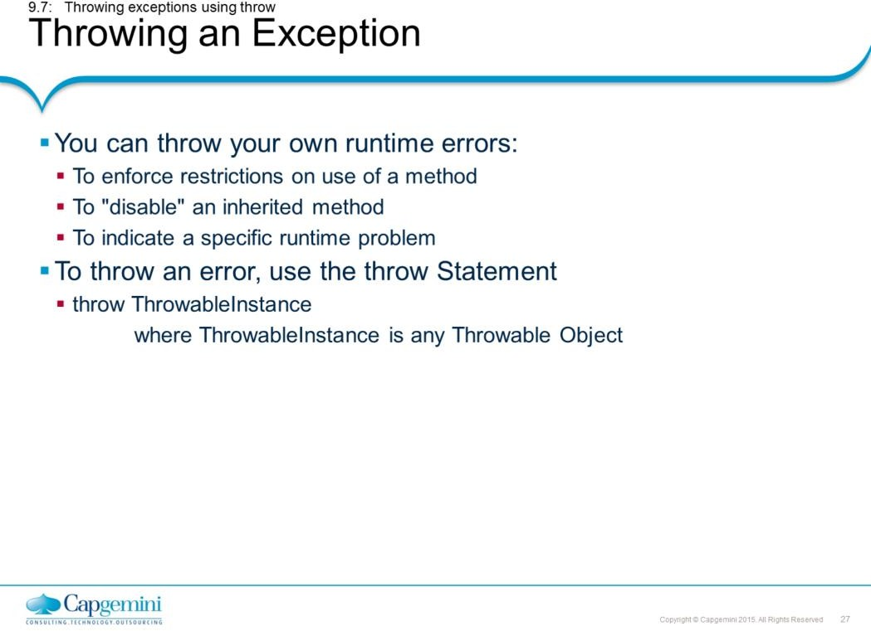
Core Java 8 and Development Tools
Exception Handling
Throwing an Exception:
It is possible for your program to throw an exception explicitly, using the throw statement.

Slide 25
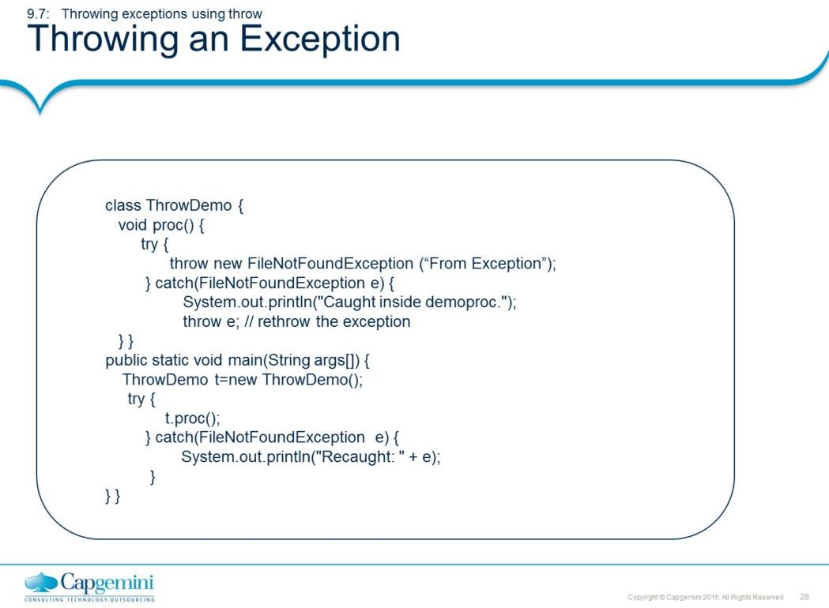
Core Java 8 and Development Tools
Exception Handling
Throwing an Exception:
This program gets two chances to deal with the same error. First, main( ) sets up an exception context and then calls proc( ). The proc( ) method then sets up another exception-handling context and immediately throws a new instance of FileNotFoundException, which is caught on the next line. The exception is then rethrown. Here is the resulting output:
Caught inside demoproc.
Recaught: java.lang.FileNotFoundException: From Exception
The program also illustrates how to create one of Java’s standard exception objects.
Example:
throw new FileNotFoundException();
Here, new is used to construct an instance of FileNotFoundException. All of Java’s built-in run-time exceptions have at least two constructors: one with no parameter and one that takes a string parameter.

Slide 26
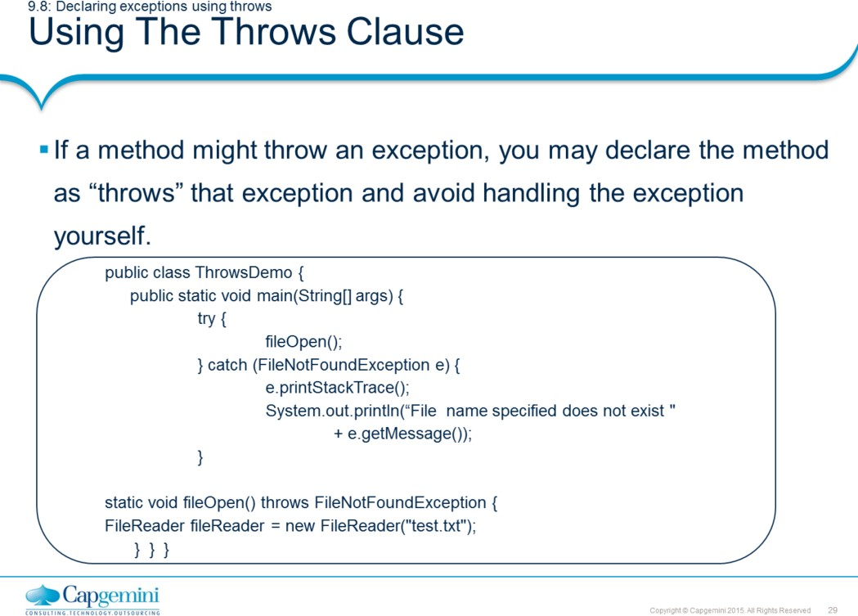
Core Java 8 and Development Tools
Exception Handling
Using The Throws Clause:
If a method is capable of causing an exception that it does not handle, it must specify this behavior so that callers of the method can guard themselves against that exception. This can be achieved by using the Throws clause in the method declaration.
The Throws clause can throw multiple exceptions separated by commas. It lists the type of exceptions that a method might throw.
Here is the output generated by running this example program:
Exception in thread "main" java.lang.ArrayIndexOutOfBoundsException: 100 at ThrowsDemo.doWork(ThrowsDemo.java:11) at ThrowsDemo.main(ThrowsDemo.java:4)
The Throws clause is added to an application to indicate to the rest of the program that this method may throw an ArithmeticException. Clients of method doWork() are thus informed that the method may throw an ArithmeticException and that the exception should be caught.

Slide 27
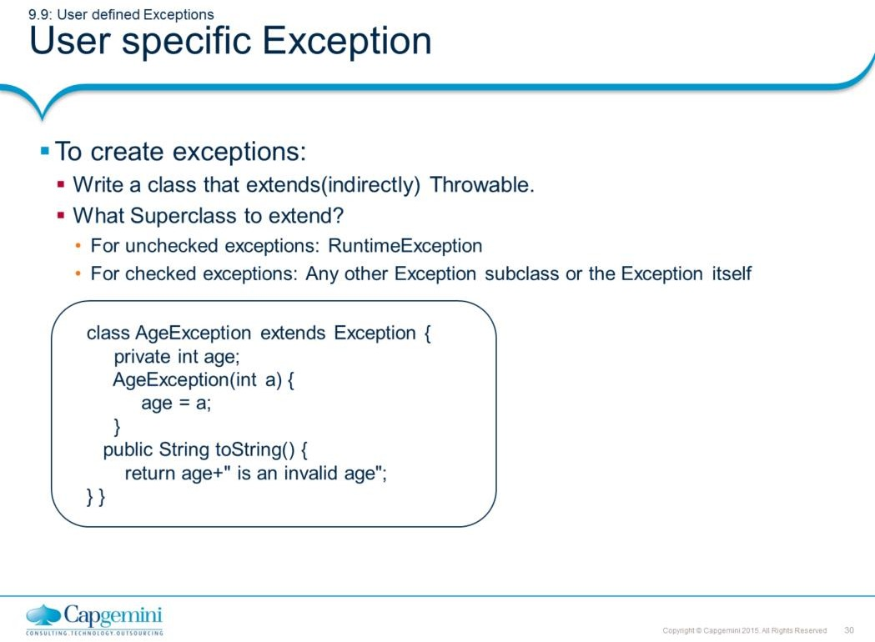
Core Java 8 and Development Tools
Exception Handling
User-Specific Exception:
To create your own exception class, you must inherit from an existing exception class, preferably one that is close in meaning to your new exception.
Define a subclass of Exception. Your subclasses don’t need to actually implement anything—it is their existence in the type system that allows you to use them as exceptions. The Exception class does not define any methods of its own. It does, of course, inherit those methods provided by Throwable. Thus, all exceptions, including those that you create, have the methods defined by Throwable available to them. The following are some of the useful methods.
String toString( ): This exception returns a String object containing a description of the exception. This method is called by println( ) when outputting a Throwable object.
String getMessage( ): This exception returns a description of the exception. void printStackTrace( ) : This exception displays the stack trace.

Slide 28
Core Java 8 and Development Tools
Exception Handling
User Specific Exception (Contd.):
Example:
import java.util.*;
class AgeException extends Exception { private int age;
AgeException(int a) { age = a; }
public String toString() {
return age+" is an invalid age"; } } class emp {
String name; int age;
void getDetails() throws AgeException { System.out.println("Enter your name:"); Scanner sc=new Scanner(System.in); name=sc.next(); System.out.println("Enter your age:"); age=sc.nextInt();
if (age<16)
throw new AgeException(age);
}}
class ExceptionDemo {
public static void main(String args[]) { try {
emp e=new emp(); e.getDetails();
}catch (AgeException e) { System.out.println( e); }
} }
This example defines a subclass of Exception called AgeException. This subclass is quite simple: it has only a constructor and an overloaded toString( ) method that displays the value of the exception. The ExceptionDemo class invokes getDetails() method of emp class. The getDetails method throws AgeException object if age is less than 16. The main( ) method sets up an exception handler for AgeException, then calls getDetails().
The output generated is as follows:
Enter your name:
Suman
Enter your age:
12
12 is an invalid age

Slide 29
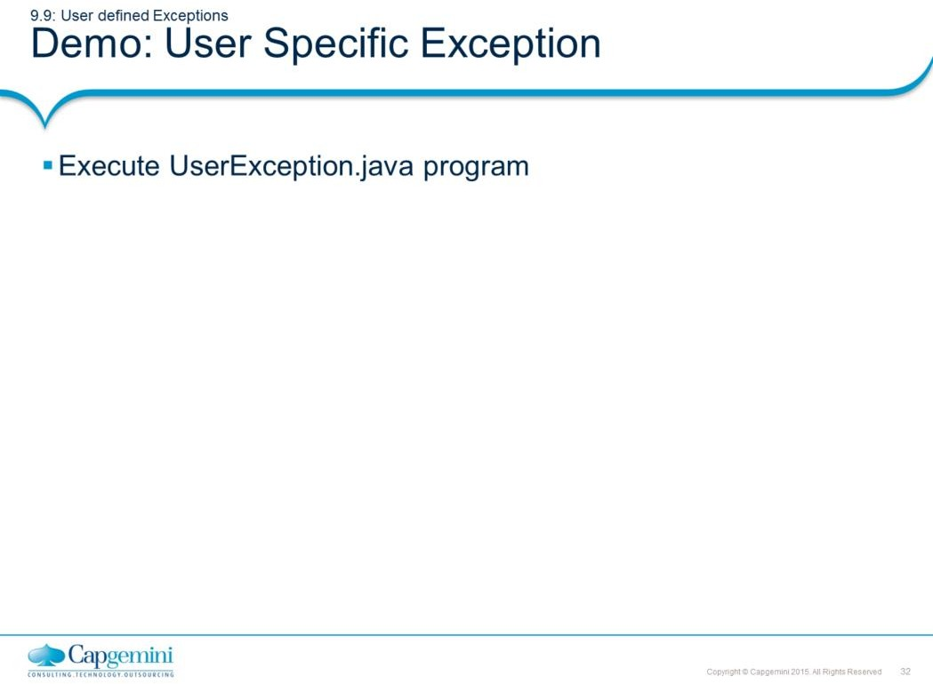
Core Java 8 and Development Tools
Exception Handling
class ApplicationException extends Exception { private int detail;
ApplicationException(int a) { detail = a; } ApplicationException(String args) { super(args); }
public String toString() {return "ApplicationException["+detail+"]"; }
}
class UserException {
static void compute(int a) throws ApplicationException { System.out.println("called compute("+a+")");
if (a>10) throw new ApplicationException(a);
System.out.println("Normal Exit");
}
public static void main(String arg[]) { try {
compute(1);
compute(20);
} catch (ApplicationException e) { System.out.println("caught "+e); }
}
}
Output:
called compute(1)
Normal Exit
called compute(20)
caught ApplicationException[20]

Slide 30
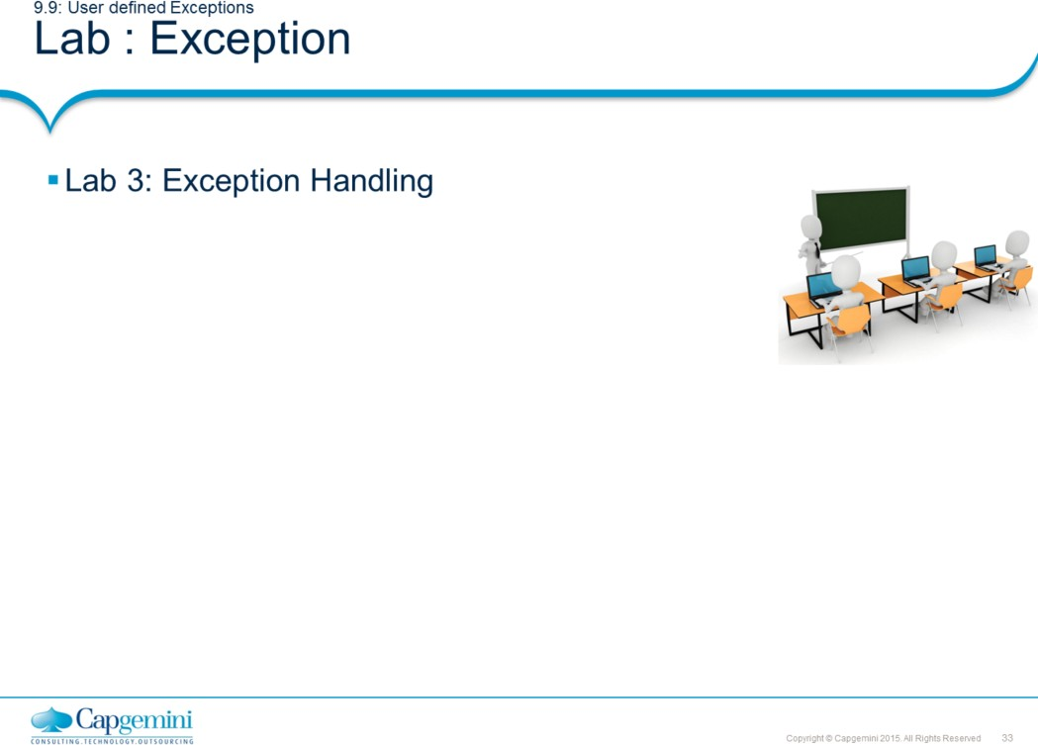
Core Java 8 and Development Tools
Exception Handling

Slide 31
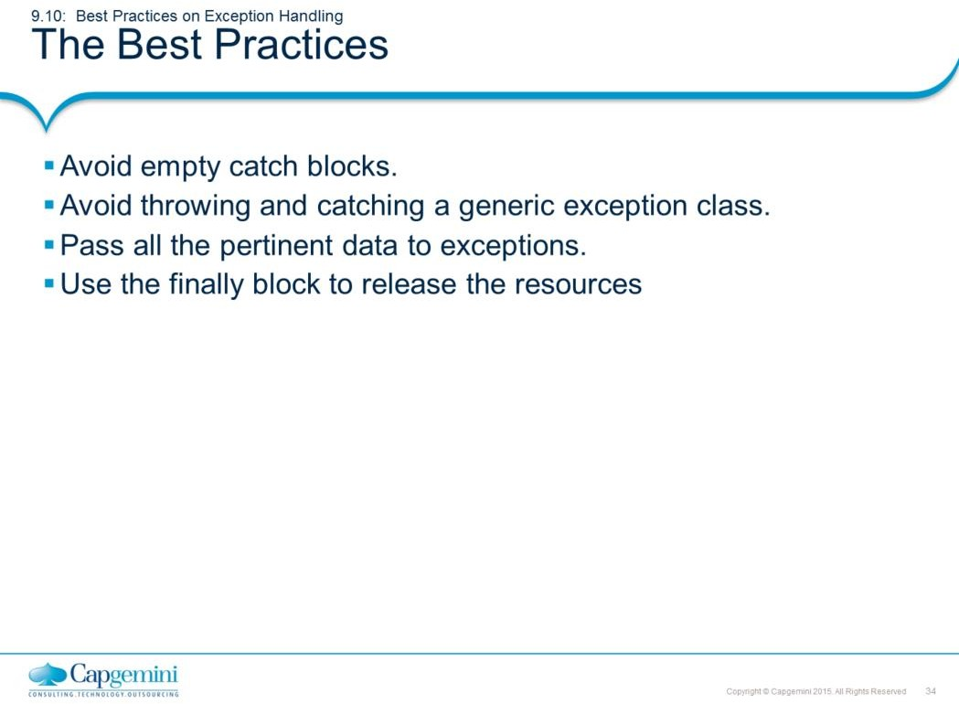
Core Java 8 and Development Tools
Exception Handling
The Best Practices:
Avoid empty catch blocks:
Most contend that it is usually not preferable to have an empty catch block.
When the exception occurs, nothing happens, and the program fails for unknown
reasons.
For example, if a problem with user input is detected and an exception is thrown as a result, then merely informing the user of the problem might be all that is required. For example, a message might read : Age must be in range 0..120
Avoid throwing and catching generic exception class:
If the exception is known then, catch a specific exception class.
In the Throws clause of a method header, be as specific as possible. Do not group together related exceptions in a generic exception class - that would represent a loss of possibly important information.
Use the finally block to release the resources like a database connection, closing a
file or socket connection, and others.
This prevents resource leaks even if an exception occurs. The Finally block always execute irrespective of whether exception is thrown or not.

Slide 32
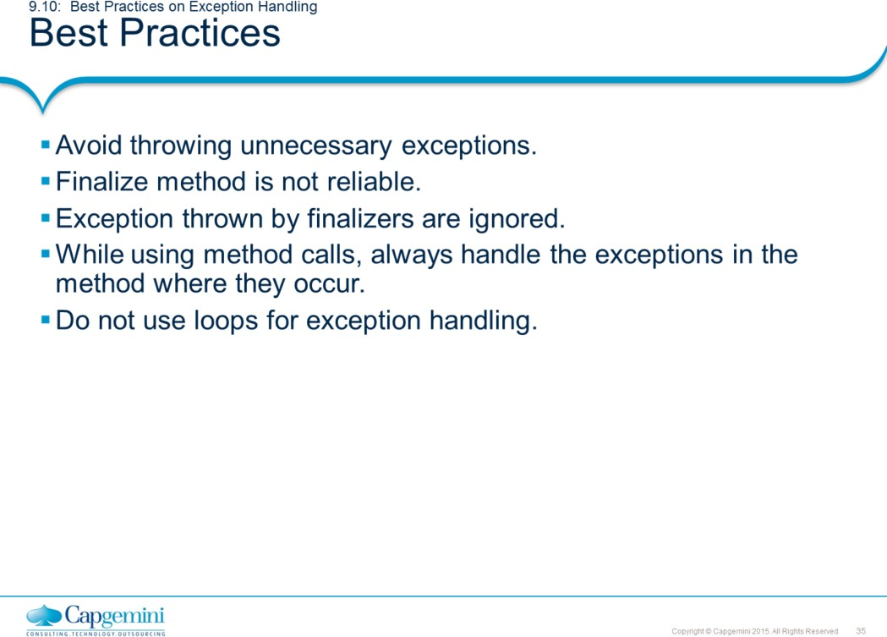
Core Java 8 and Development Tools
Exception Handling
Best Practices:
Avoid Throwing Unnecessary Exceptions: Creating and throwing an exception is a time-consuming process, so you should avoid throwing exceptions when it's not necessary to do so. For example, you might define a method such as the one shown here that returns an object from a list until there are no more in the list. If the method is invoked when there are no objects remaining in the list, a NoMoreObjectsException is thrown:
public Object getNextObject() throws NoMoreObjectsException {
// ...
}
Instead of throwing a NoMoreObjectsException when there are no objects remaining in the list, you might change this method so that it returns a null value, which will allow your code to execute more quickly when that occurs.
Finalize method is not reliable: Since the Garbage collector is JVM specific and it is not always sure when the garbage collector is invoked, it is thus not sure when the finalize method is executed. So, avoid releasing resources which are important and are to be referred again in the code using the finalize method.

Slide 33
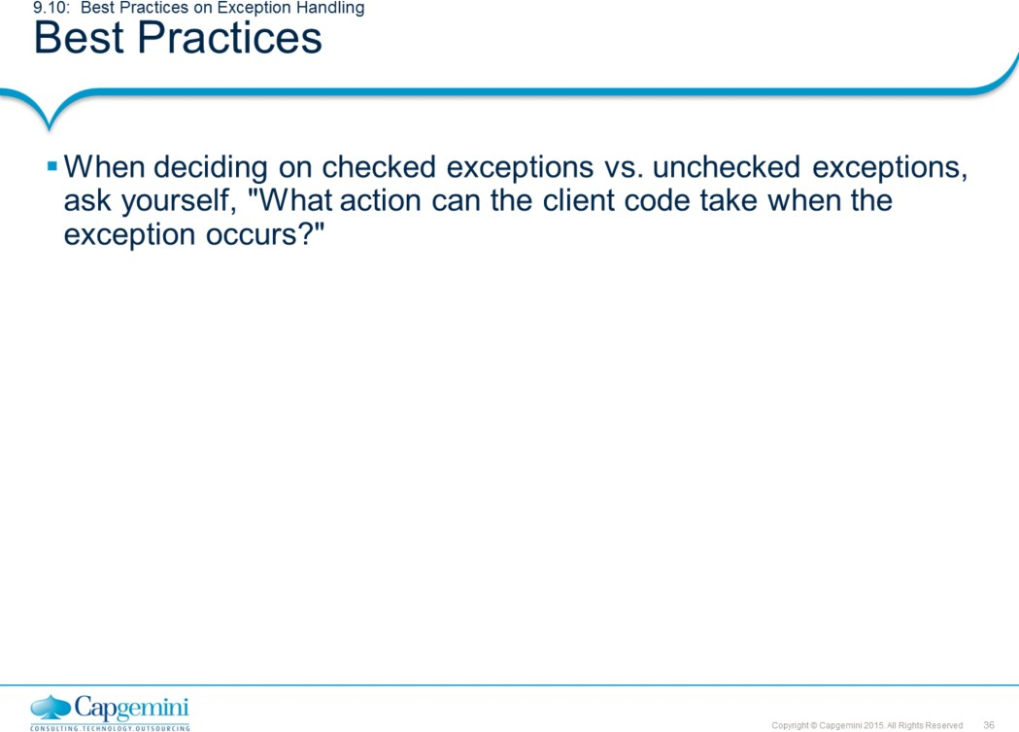
Core Java 8 and Development Tools
Exception Handling
Best Practices:
Always remember that exceptions thrown by finalizers are ignored.
While using method calls, always handle the exceptions in the method where they occur. Do not allow them to propagate to the calling method unless it is specifically required. It is efficient to handle them locally since allowing them to propagate to the calling method takes more execution time.
Do not use Exception handling in loops. It is better to place loops inside the try or catch block than vice versa.
Using Check or Uncheck Exception:
If the client can take some alternate action to recover from the exception, make it a checked exception. If the client cannot do anything useful, then make the exception unchecked. Being useful means, able to take steps to recover from the exception and not just log the exception. To summarize:
Client's reaction when exception happens | Exception type
1.Client code cannot do anything | 1.Make it an unchecked exception
2.Client code will take some useful recovery | 2. Make it a checked action based on information in exception

Slide 34
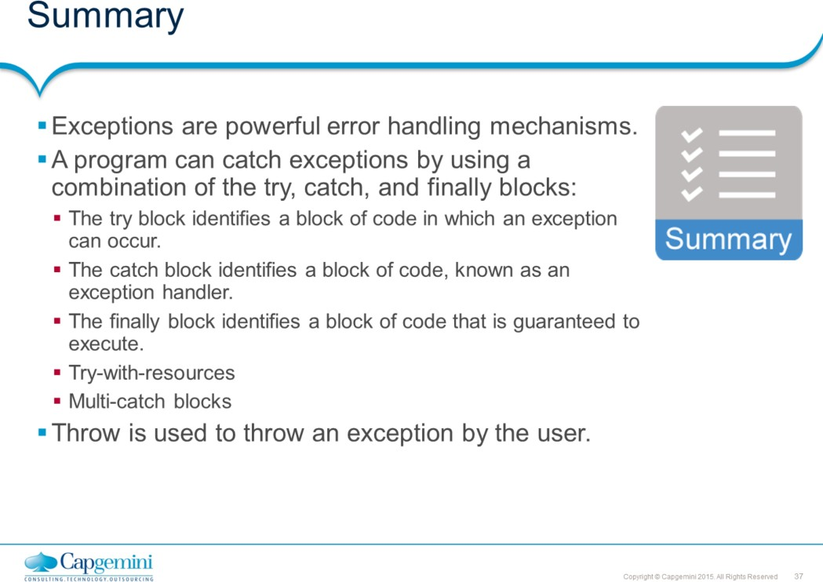
Core Java 8 and Development Tools
Exception Handling
Add the notes here.

Slide 35
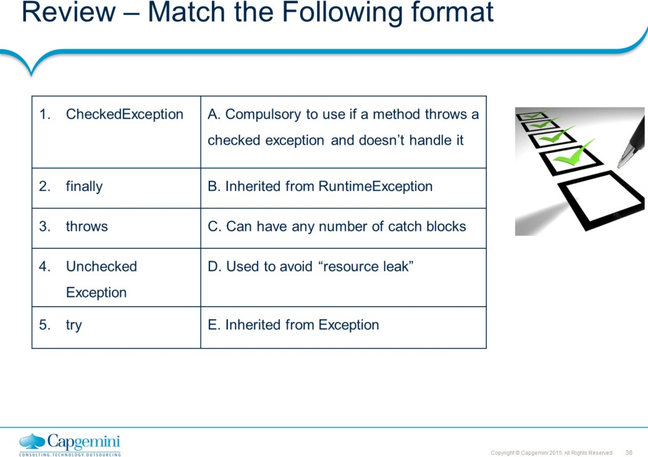
Core Java 8 and Development Tools
Exception Handling

